Slide 1
Meeting 6
01/02/2018

Slide 2
Agenda
Gantt chart
Park model
Next steps

Slide 3
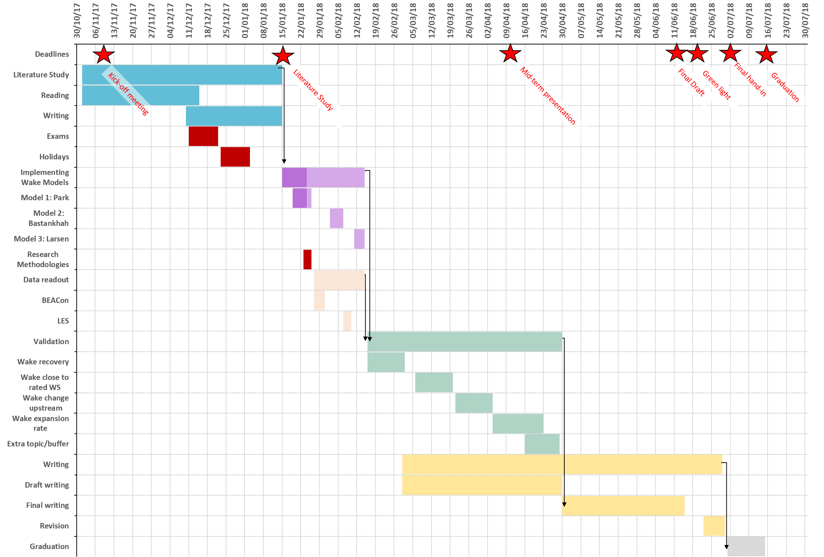

Slide 4
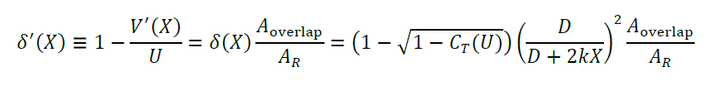
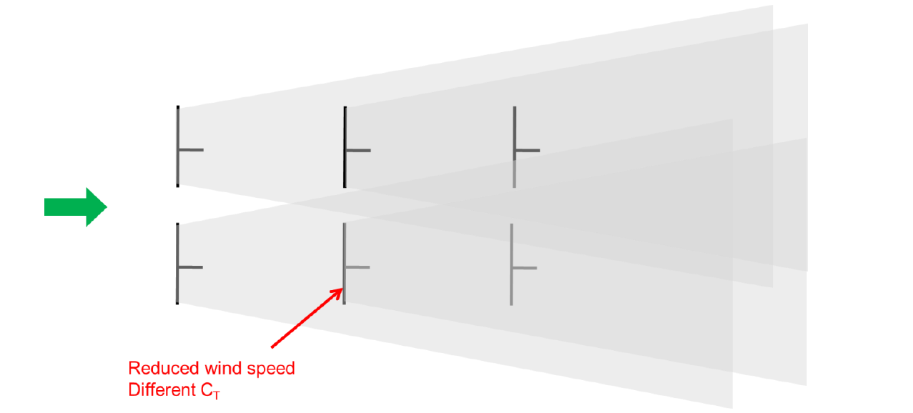
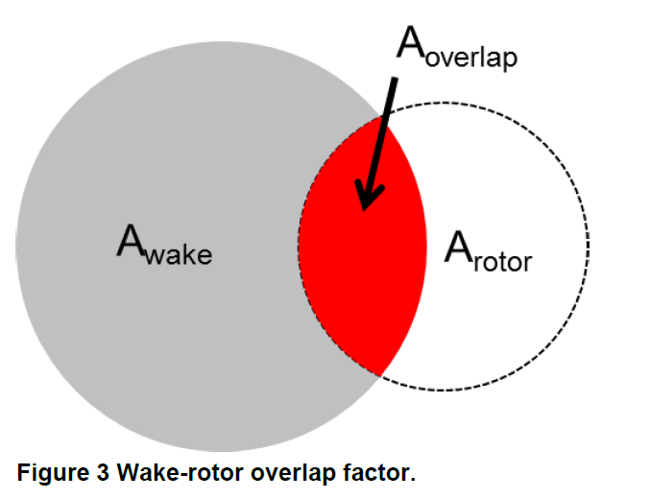
Park model

Slide 5
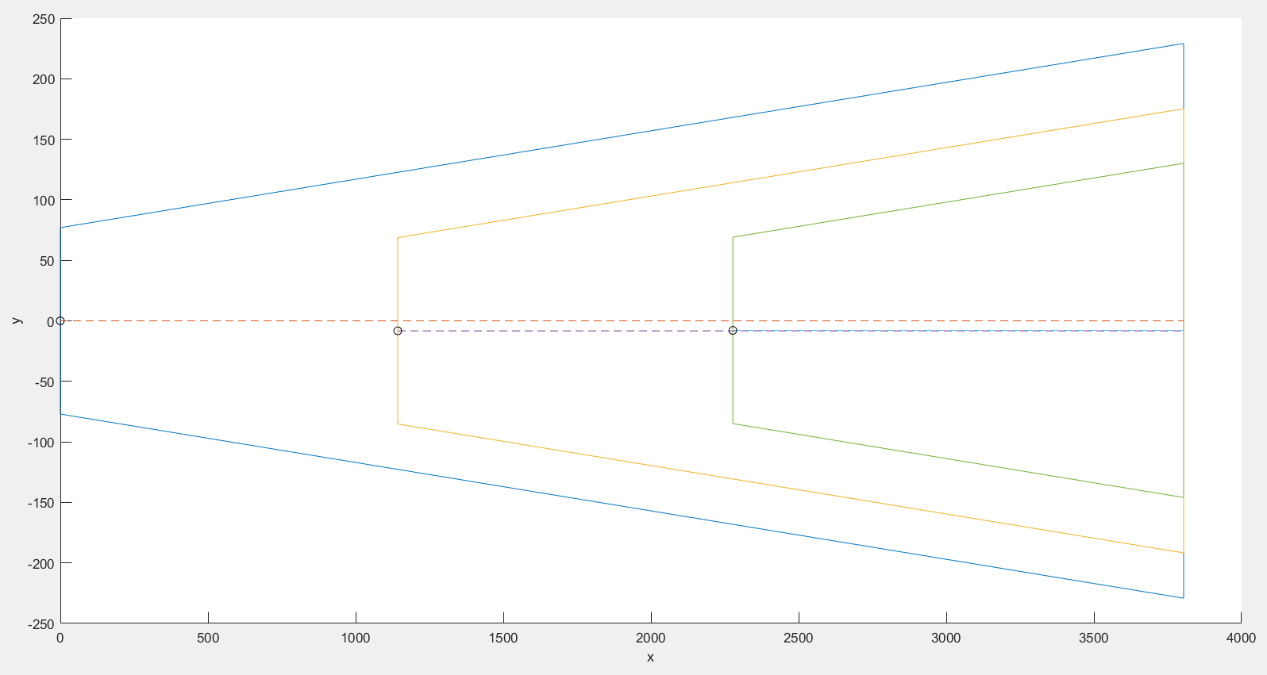
Park model

Slide 6
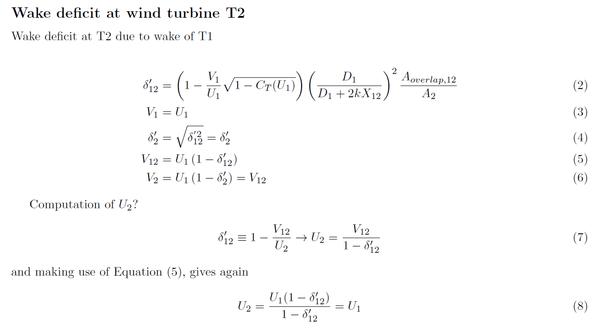
Park model – Question

Slide 7
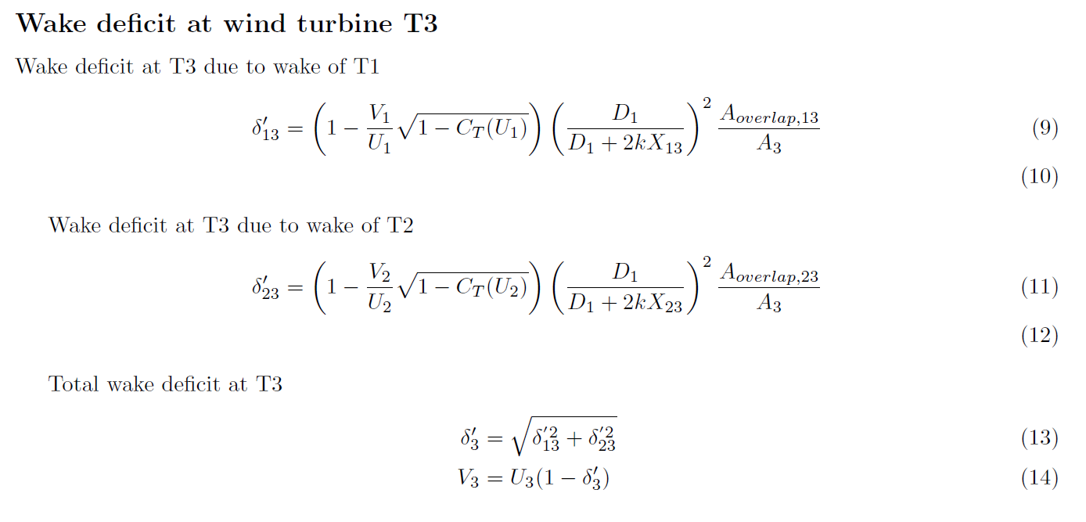
Park model - Question

Slide 8
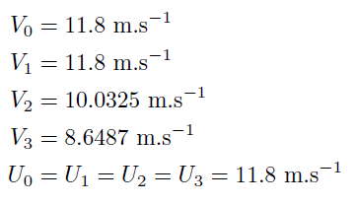
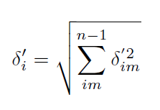

Park model – wrong solution
Step 1: Calculation of $U_{2}$, $V_{2}$ & $U_{3}$, $V_{3}$ & …
Step 2: Calculation of deficit in a particular point
Define in which wake point is located
Calculate deficit making use of

Slide 9
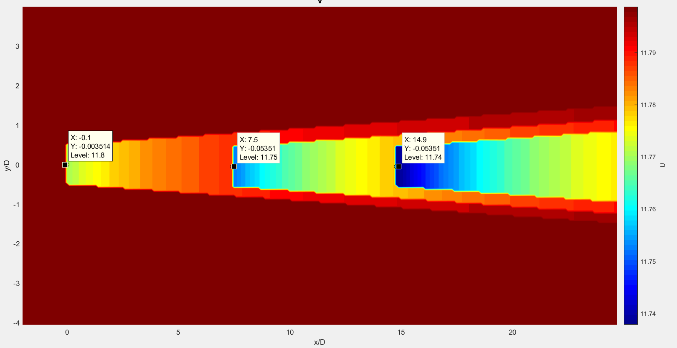
Park model – wrong solution

Slide 10
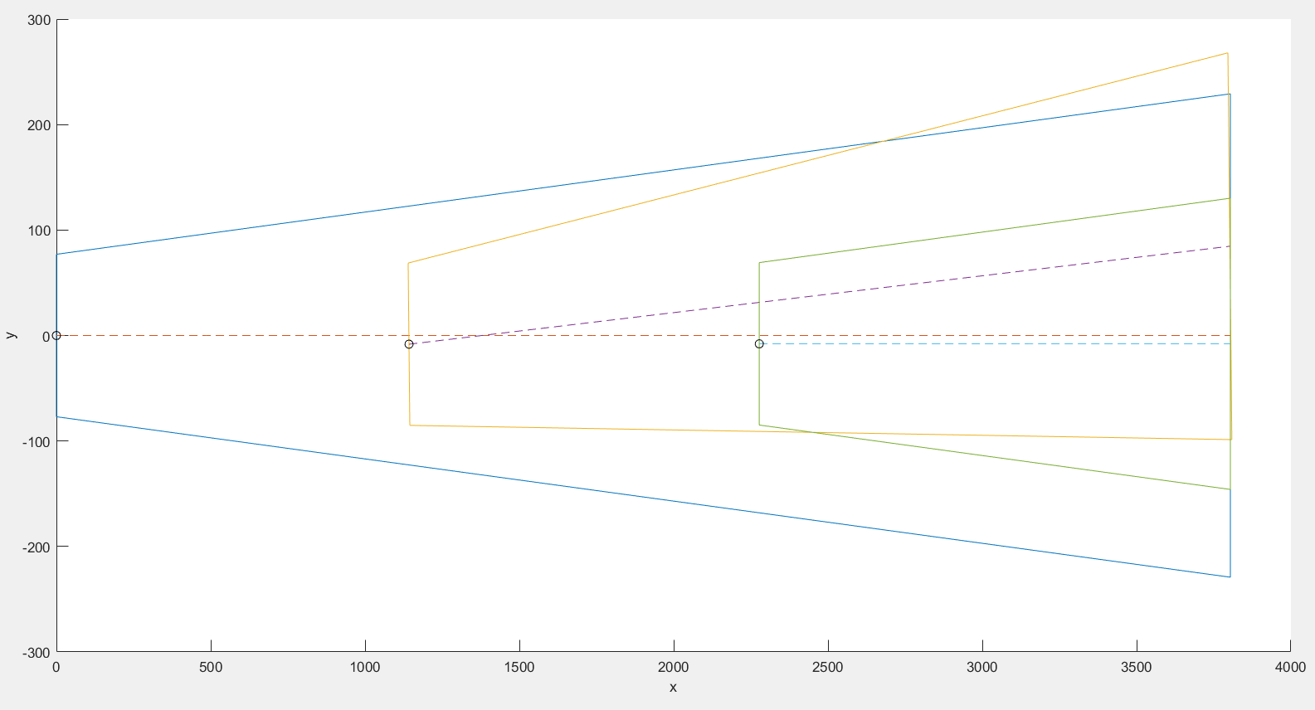
Park model – yawed wake

Slide 11
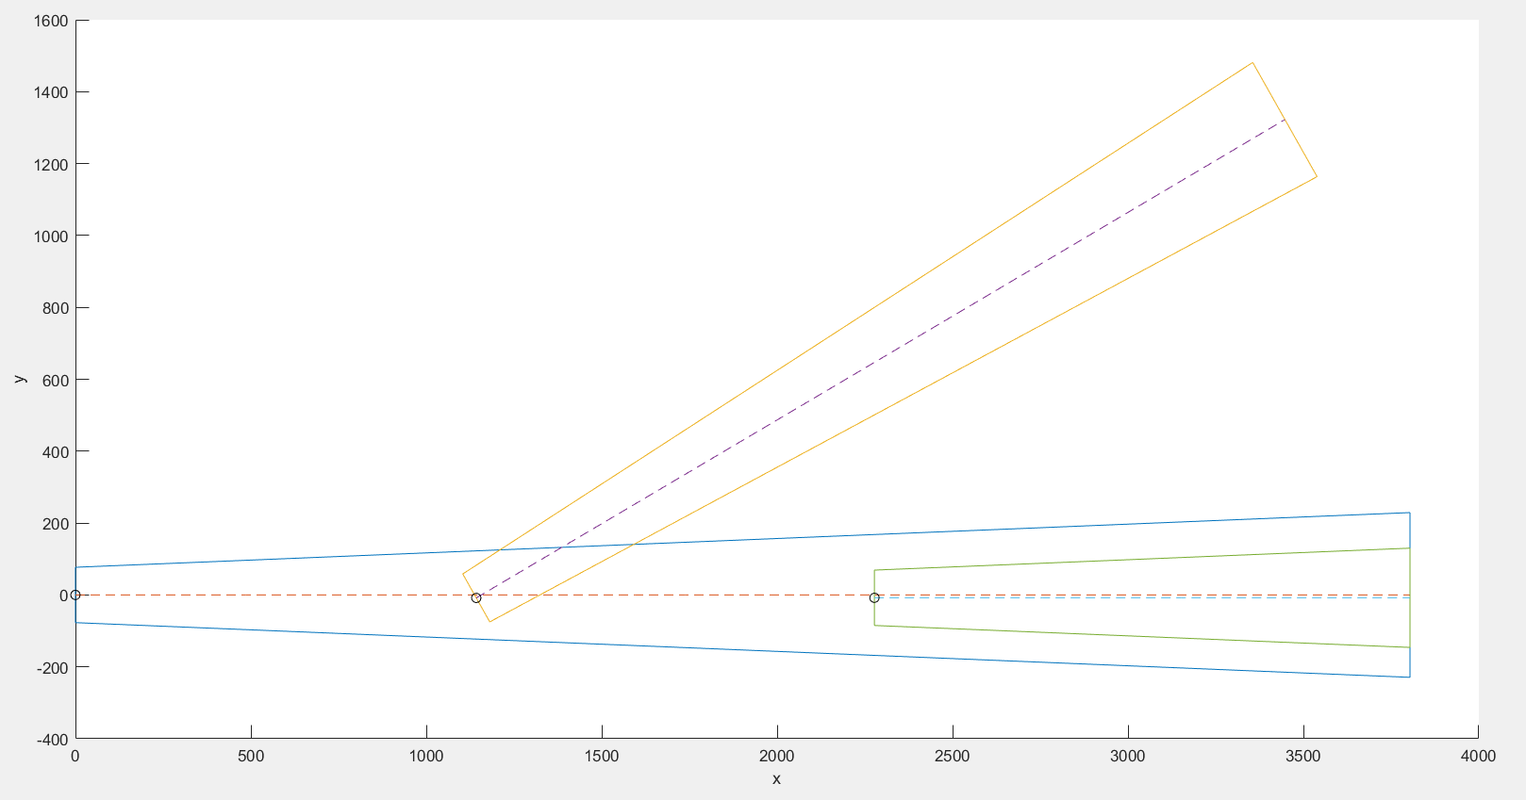
Park model – yawed wake
Do you need to project the areas?

Slide 12
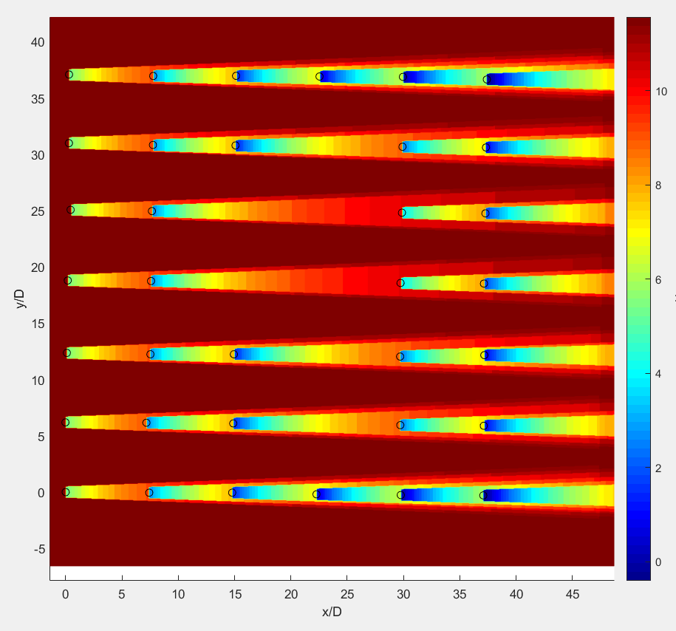
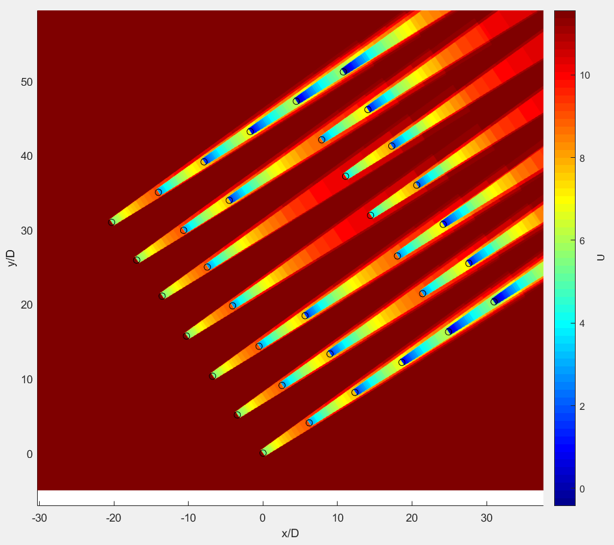
Park model – version 1

Slide 13
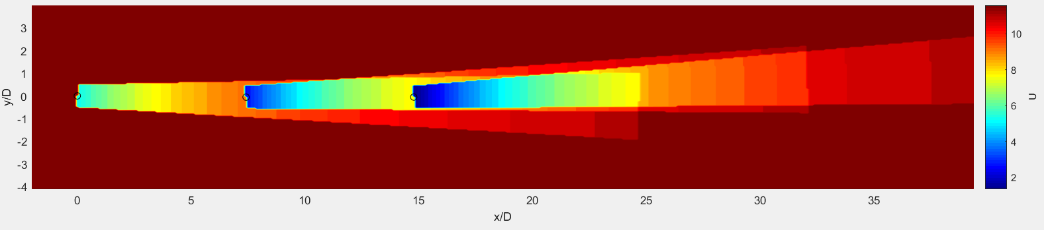
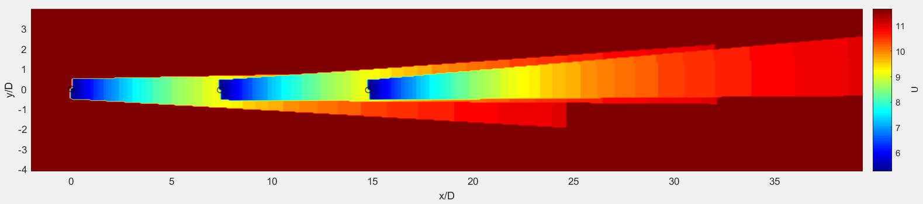
Linear superposition
Maximum deficit

Slide 14
Next steps
Correct/Finish Park model + different height
Read BEACon data (example)
Read LES data

